Slide 1

FACE MASK DETECTION USING MACHINE LEARNING
-An Approach to Reduce Risk of Corona Virus Spread
Team Members:
Under the Esteemed Guidance of
Mr. K. Sudhakar,
Asst. Professor, IT Department
1.19pa1a1263 K VINAY SANDEEP
2.19pa1a1261 K YASASWI PUJITHA
3.19pa1a1228 C GOPICHAND
4.19pa1a1219 B JOSHNA
DEPARTMENT OF IFORMATION TECHNOLOGY
VISHNU INSTITUTE OF TECHNOLOGY(A), BHIMAVARAM
(Approved by AICTE, Permanently affiliated to JNTUK, Accredited by NBA & NAAC)

Slide 2
CONTENTS
PROBLEM STATEMENT
BLOCK DIAGRAM
RESULTS
CONCLUSION
REFERENCES

Slide 3
PROBLEM STATEMENT
In the present situations, people are not wearing masks in the public places like shopping malls, banks etc.
To overcome this problem, we came up with an idea to use a detector that clicks the pictures of human beings continuously.
It detects from their faces whether they are wearing a mask or not without manual involvement.
This detector is helpful to detect the people faces using image processing and machine learning.

Slide 4
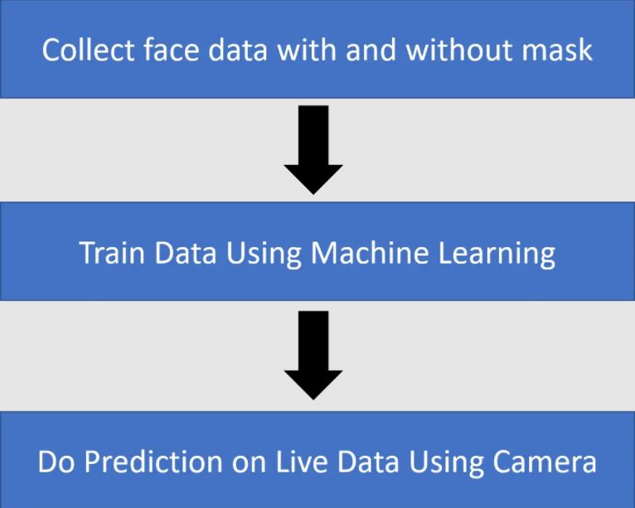
BLOCK DIAGRAM

Slide 5
RESULTS
This face mask detector is programmed using python and its libraries like Opencv,Matplotlib etc.
It will be able to detect the faces of human beings using image processing i.e in the opencv library.
This detector can also be able to detect the human faces through the Webcam and gives the output whether they are wearing a face mask or not.

Slide 6
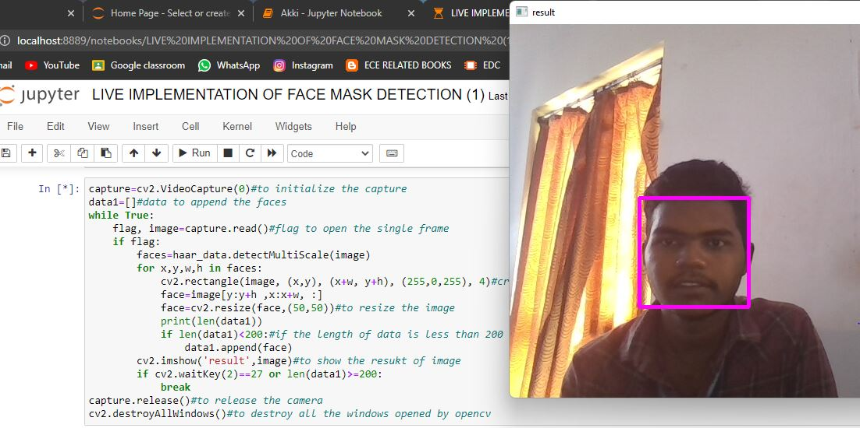
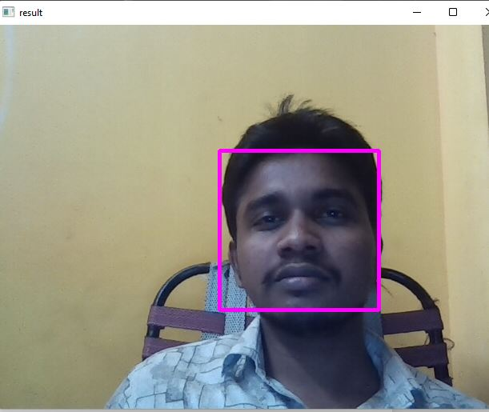
Fig 1:COLLECTING FACES WITHOUT MASK DATASET USING SYSTEM CAMERA

Slide 7
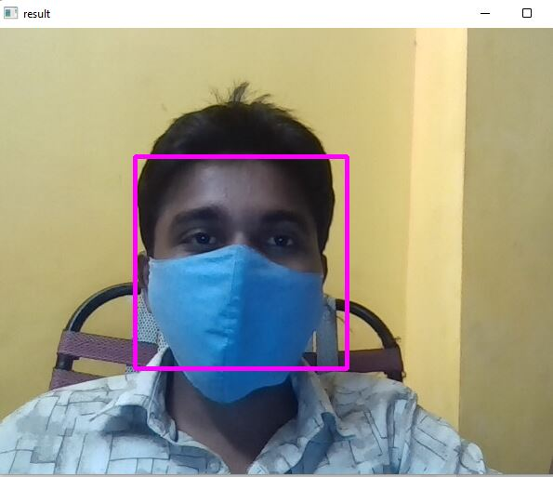
Fig 2 :COLLECTING FACES WITH MASK DATASET USING SYSTEM CAMERA

Slide 8
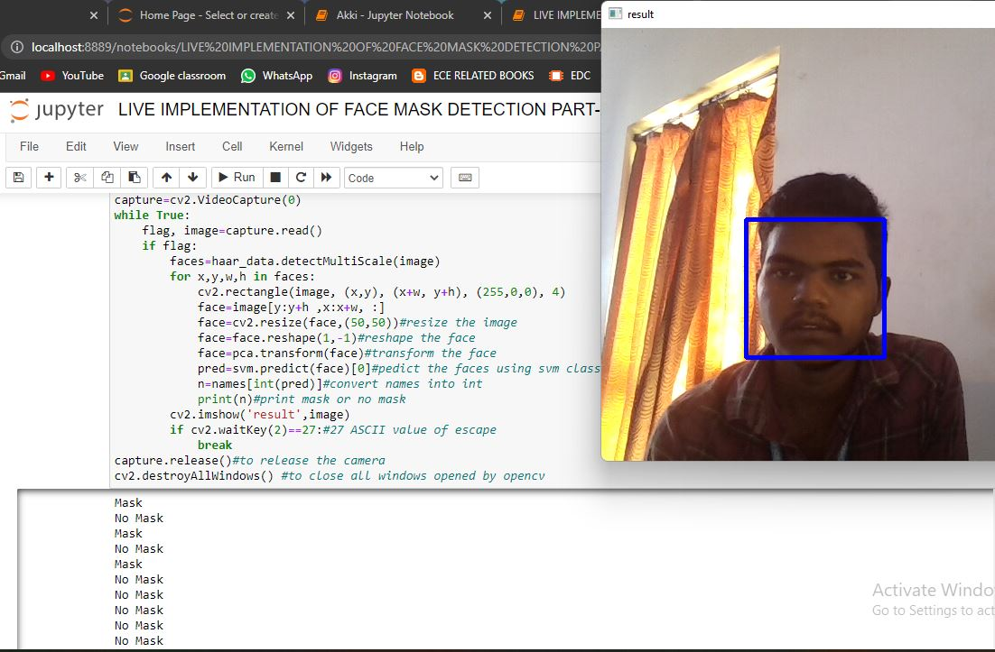
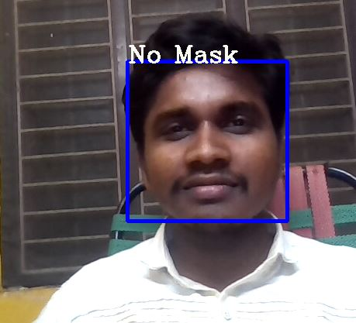
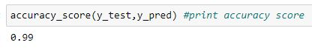
Fig 3:DETECTION OF FACE WITHOUT MASK USING SYSTEM CAMERA

Slide 9
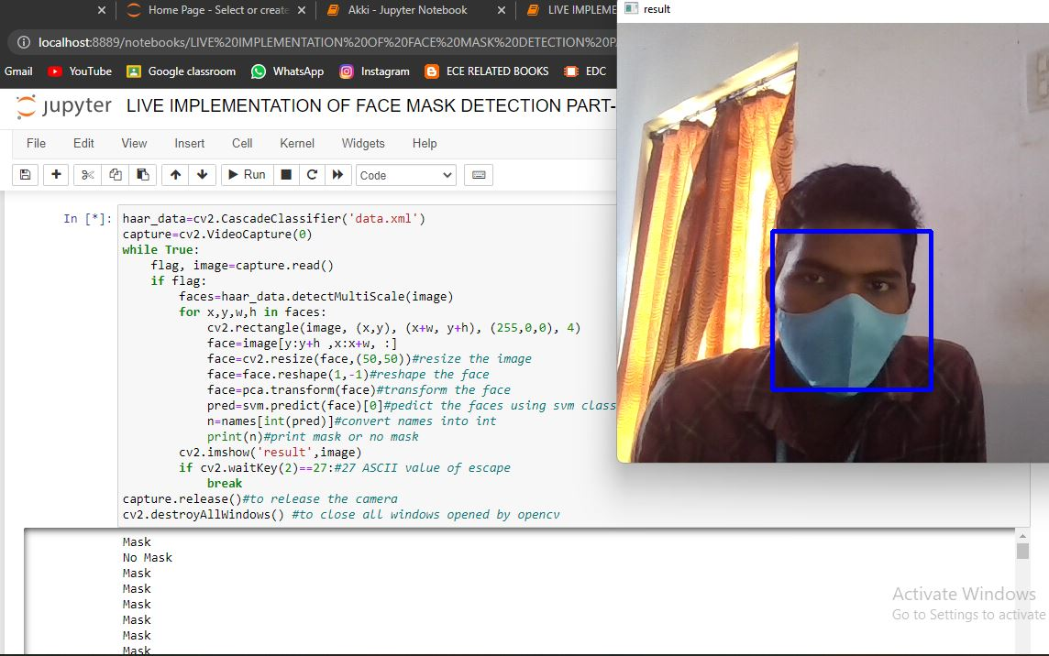
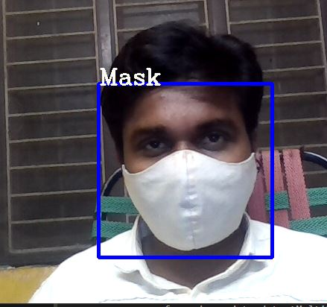
Fig 4:DETECTION OF FACE WITH MASK USING SYSTEM CAMERA

Slide 10
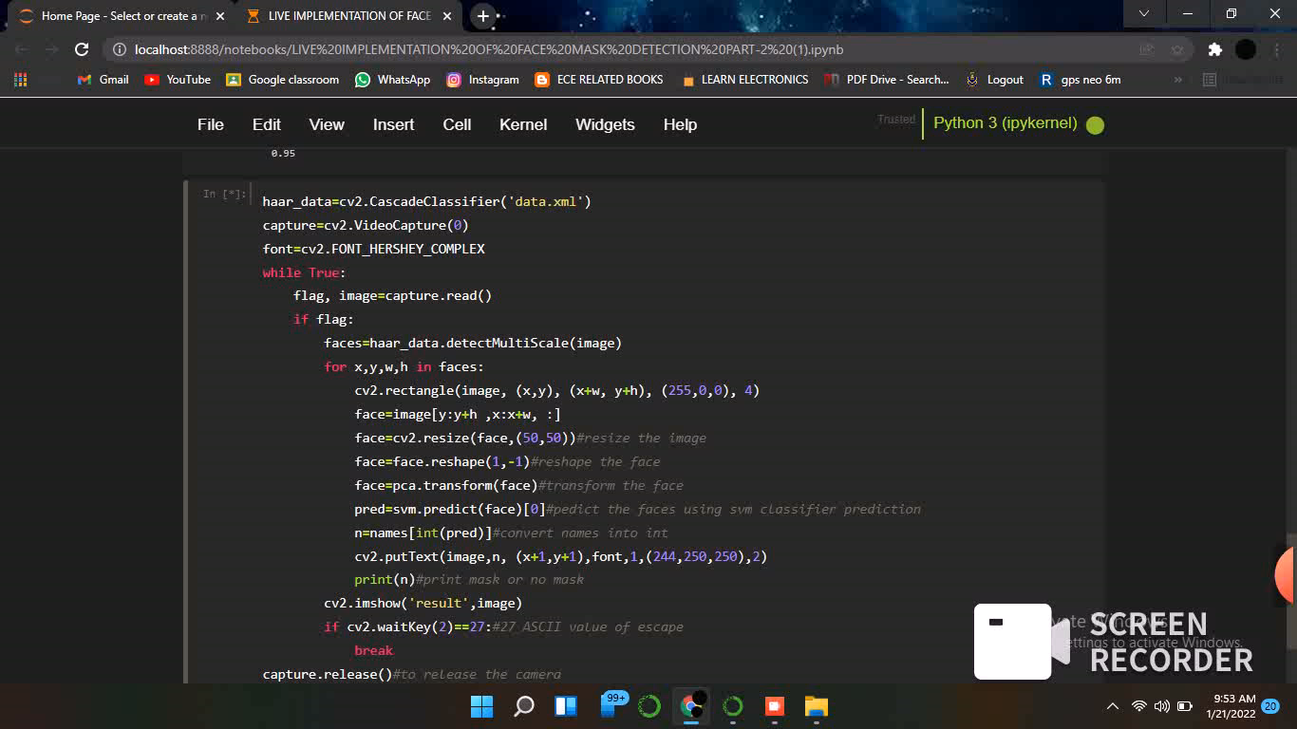

Slide 11
CONCLUSION
Our effort behind this project is to design and fabricate a gadget which is so compact in itself that provides an advantage of reducing corona virus spreading around the world. For this we built a model of face mask detection system which can be used at public places like shopping malls, banks and other crowded places etc.This real-time face mask detector can be implanted anywhere and we can penalize people by recognizing their faces. This model can be installed within the devices with minimum RAM and it is low cost reliable. This model can also be implemented using some microcontroller devices and IOT devices, using the above devices it can be made more preferable to people to use in their hands. With this we are looking forward to reduce the spread of corona virus.

Slide 12
REFERENCES
Das, Arjya, Mohammad Wasif Ansari, and Rohini Basak. "Covid-19 Face Mask Detection Using TensorFlow, Keras and OpenCV." 2020 IEEE 17th India Council International Conference (INDICON). IEEE, 2020.
Loey, Mohamed, et al. "A hybrid deep transfer learning model with machine learning methods for face mask detection in the era of the COVID-19 pandemic." Measurement 167 (2021): 108288.
Adusumalli, Harish, et al. "Face Mask Detection Using OpenCV." 2021 Third International Conference on Intelligent Communication Technologies and Virtual Mobile Networks (ICICV). IEEE, 2021.

Slide 13
THANK YOU

